Slide 1

TIRTC Project: Healthcare Analytics for Doctor Visits
Student Name : PRAGYA SRIVASTAVA
College Name :DELHI TECHNICAL CAMPUS,GREATER NOIDA(AFFILIATED TO GURU GOBIND SINGH INDRAPRASTHA UNIVERSITY,NEW DELHI)
AICTE STU ID : STU68639e54e89091751359060

Slide 2

PROBLEM STATEMENT
Healthcare utilization and doctor visits are influenced by personal demographics, health conditions, chronic illnesses, socioeconomic backgrounds, and healthcare support systems. As a result, patient healthcare needs and visit frequencies may differ significantly across different population segments. However, raw healthcare data does not clearly explain how these factors interact or what underlying patterns drive frequent doctor visits. The problem is to analyze the given healthcare dataset and investigate patterns in doctor visits by identifying meaningful trends, relationships, and variations related to patient health, financial status, and healthcare support within the available data.

Slide 3
PROJECT DESCRIPTION
This project analyzes Healthcare Utilization for Doctor Visits to understand how patient healthcare visits change across different demographics and health profiles. It studies the influence of personal demographics, financial factors, health conditions, chronic illnesses, and healthcare support systems on doctor visit frequency.
Key Areas of Analysis
Data Cleaning: This handles missing values, duplicates, data types, and outliers.
Demographic & Patient Analysis: Here comparison of visit frequency across gender, age groups, and personal characteristics takes place.
Relationship Analysis: Here the effect of illness scores, reduced activity days, and general health indicators on doctor visits is observed and analyzed.
Health & Clinical Analysis: This handles the impact of chronic and long-term health conditions on healthcare utilization.
Economic & Support Analysis: Here the influence of income levels and healthcare safety nets/insurance coverage (private, free care) on doctor consultations is analyzed.
Statistical & Correlation Analysis: Identification of significant relationships and patterns takes place.
Visualizations: Bar charts, box plots, scatter plots, heatmaps, correlation matrices, and violin plots are used.
This project identifies and analyzes patient utilization trends, important healthcare drivers, unusual patterns, and demographic differences leading to data-driven recommendations for better medical resource allocation, public health planning, and healthcare accessibility.

Slide 4

WHO ARE THE END USERS?
This project can be useful for anyone involved in healthcare planning, monitoring, and decision-making, such as:
Patients & Individuals – They can better understand how personal health factors, chronic conditions, and lifestyle elements relate to healthcare utilization and doctor visits.
Healthcare Policymakers & Government Departments – Support public health planning, policy making, and efficient medical resource allocation across different population demographics.
Healthcare Planners & Medical Analysts – Analyze patient visit trends and identify key clinical and socioeconomic drivers of healthcare demand.
Clinic & Hospital Administrators – Optimize resource efficiency, staffing, and service delivery based on patient volume and health profiles.
Researchers & Data Analysts – Study relationships between health indicators, financial backgrounds, and healthcare support systems.
Health Insurance & Support Organizations – Understand utilization patterns related to private insurance and safety net programs to support better coverage decisions.
Overall, the project is designed to support data-driven healthcare decision-making and better public health planning for maximizing care efficiency and optimizing resource utilization.

Slide 5

TECHNOLOGY USED
Core Environment & Libraries
Programming Language: Python
Development Environment: Google Colab
Data Processing & Manipulation: Pandas, NumPy
Data Visualization: Matplotlib, Seaborn
Statistical Analysis: SciPy
Machine Learning: Scikit-learn
Visualizations & Analysis Implemented
Bar & Count Plots: Compared gender distribution, doctor visit frequencies, and chronic condition proportions.
Horizontal Bar Graphs: Presented category-wise comparisons of healthcare utilization and insurance status.
Pie Charts: Showed proportions of private health insurance holders and welfare program beneficiaries.
Histograms & Box Plots: Analysed distributions of patient age, income, and number of illnesses/illness days.
Scatter Plots: Examined relationships between income, age, and healthcare visits.
Pair Plots: Visualized relationships and distributions among numerical health and demographic variables.
Heatmaps: Displayed correlations between health status, chronic conditions, doctor visits, and socioeconomic factors.
Raincloud/Violin-Box Hybrid Plots: Compared health status distribution and spread across demographic categories.
ECDF (Empirical Cumulative Distribution Function): Analysed cumulative distribution of income and health metrics.
Correlation Analysis: Identified relationships among visits, illness, health status, income, and insurance coverage.

Slide 6
TECHNOLOGY USED
Analytical Techniques Applied
Data Cleaning & Missing Value Handling
Duplicate & Outlier Detection
Exploratory Data Analysis (EDA)
Univariate, Bivariate & Multivariate Analysis
Descriptive Statistics
Demographic & Health Status Comparison
Healthcare Utilization & Access Analysis
Predictive Analysis using Machine Learning
Dataset
Source: Healthcare Analytics for Doctor Visits Dataset
Description: The dataset represents doctor visits, health status, illness indicators, and socioeconomic variables of individuals. It contains information related to patient demographics, income, number of illnesses, restricted activity days, health assessment scores, private health insurance, and government welfare programs (freepoor, freerepat, nchronic, lchronic).
Size: Contains 5,190 records with 13 variables.
Key Features: visits, gender, age, income, illness, reduced, health, private, freepoor, freerepat, nchronic, and lchronic.

Slide 7
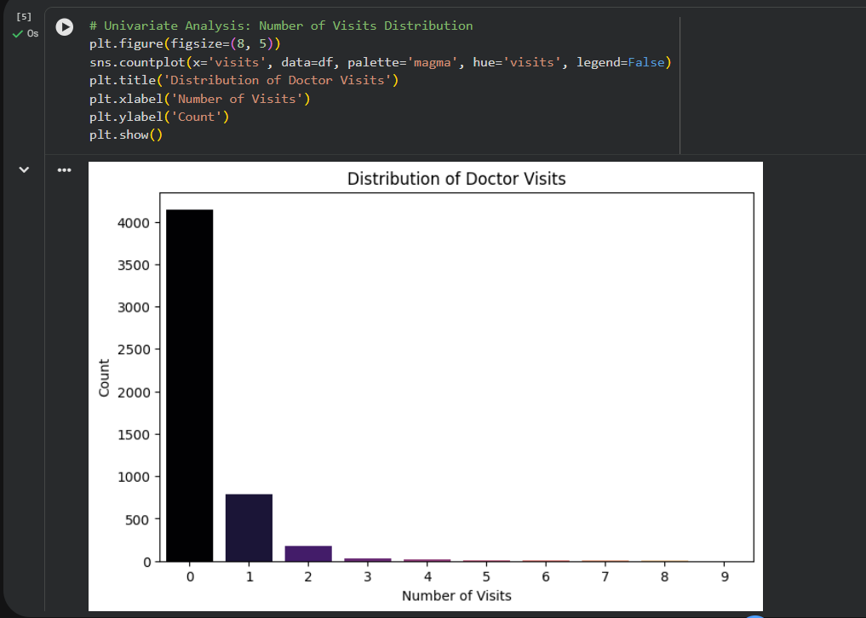
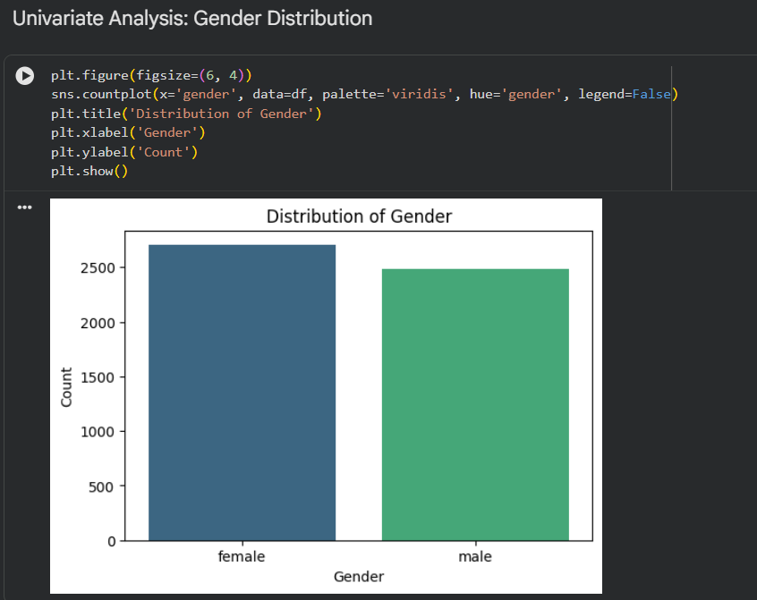
RESULTS: COUNT PLOT GRAPHS
Here is a summary description of the plots displayed in the analysis results:
Distribution of Doctor Visits (Left Plot): A count plot illustrating the frequency of doctor visits among individuals. The distribution is heavily right-skewed, showing that the vast majority of patients had $0$ visits, with rapidly decreasing counts for $1$, $2$, and higher numbers of visits.
Distribution of Gender (Right Plot): A count plot comparing the demographic breakdown of participants by gender. It displays the count of female versus male individuals, demonstrating a relatively balanced representation in the dataset.
https://github.com/pragyasrivastavaaa/TIRTC-PROJECT-VOIS-INTERNSHIP-Healthcare-Analytics-for-Doctor-Visits.git

Slide 8
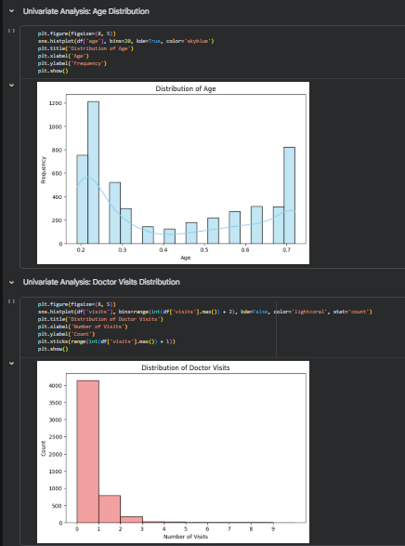
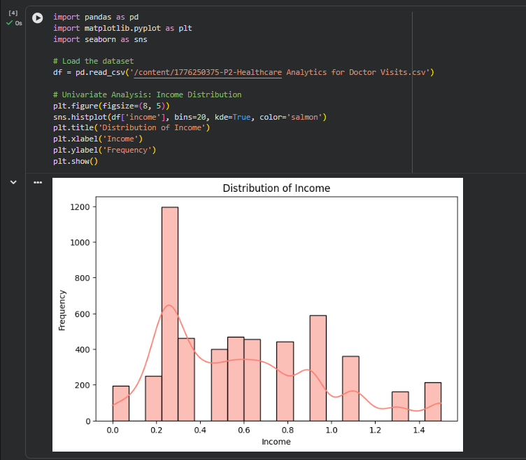
RESULTS: HISTOGRAMS
Here is a summary description of the histograms displayed in the analysis results:
Distribution of Age (Top Left): A histogram displaying the frequency and spread of patient ages within the dataset.
Distribution of Doctor Visits (Bottom Left): A histogram illustrating the frequency of doctor visits per individual, showing a heavily right-skewed distribution where the vast majority of patients recorded zero or one visit.
Distribution of Income (Right): A histogram overlaid with a Kernel Density Estimate (KDE) curve representing the frequency distribution of patient income levels.
https://github.com/pragyasrivastavaaa/TIRTC-PROJECT-VOIS-INTERNSHIP-Healthcare-Analytics-for-Doctor-Visits.git

Slide 9
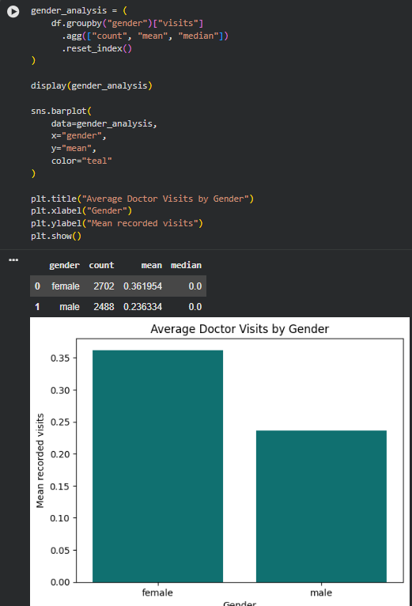
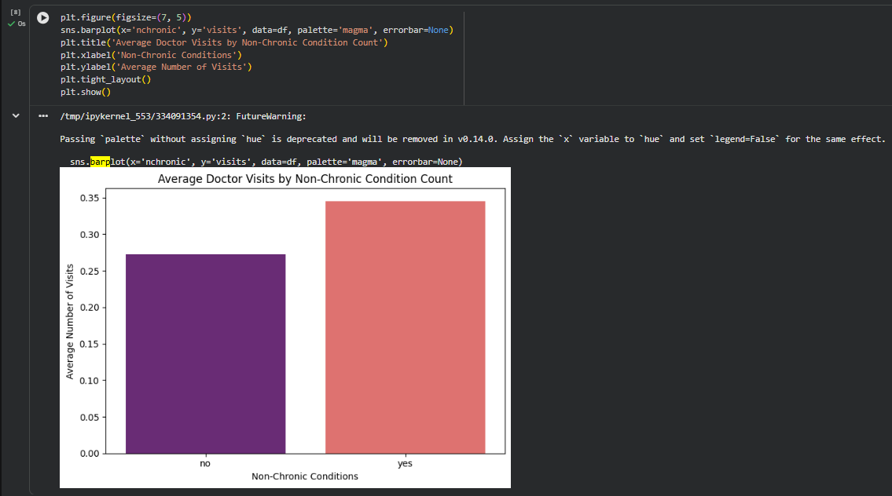
RESULTS: BAR PLOTS
Here is a summary description of the bar plots displayed in the analysis results:
Average Doctor Visits by Gender (Left Plot): A bar chart comparing the mean number of recorded doctor visits between female and male patients. It shows that female participants have a higher average number of visits compared to male participants.
Average Doctor Visits by Non-Chronic Condition Count (Right Plot): A bar chart illustrating the relationship between the presence of non-chronic conditions (nchronic) and the average number of doctor visits, indicating higher utilization for those with reported conditions.
https://github.com/pragyasrivastavaaa/TIRTC-PROJECT-VOIS-INTERNSHIP-Healthcare-Analytics-for-Doctor-Visits.git

Slide 10
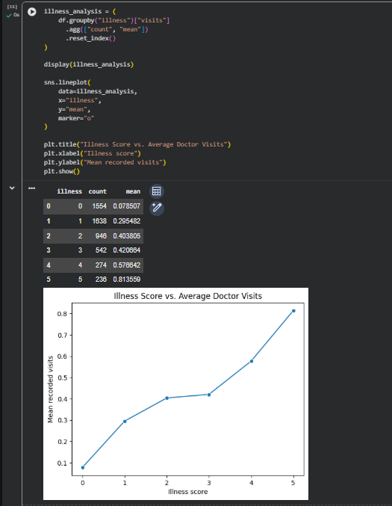
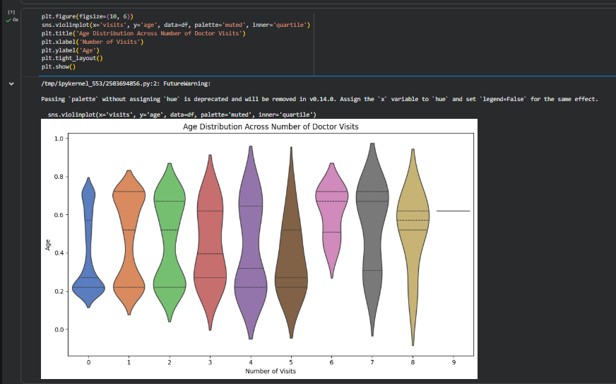
RESULTS: LINE PLOT & VIOLIN PLOT
Here is a summary description of the plots displayed in the analysis results:
Illness Score vs. Average Doctor Visits (Left Plot): A line plot illustrating the relationship between a patient's illness score and their mean recorded doctor visits, showing a clear upward trend as illness scores increase.
Age Distribution Across Number of Visits (Right Plot): A violin plot displaying the distribution and data spread of patient ages across different numbers of doctor visits.
https://github.com/pragyasrivastavaaa/TIRTC-PROJECT-VOIS-INTERNSHIP-Healthcare-Analytics-for-Doctor-Visits.git

Slide 11
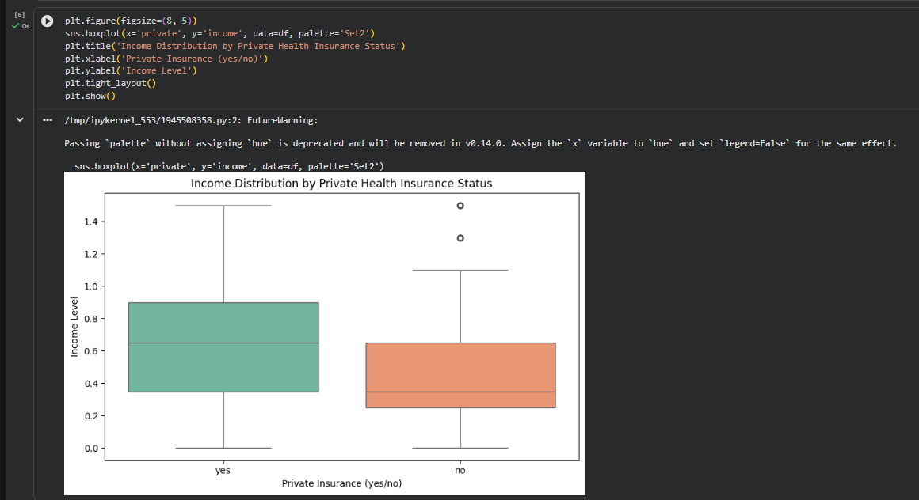
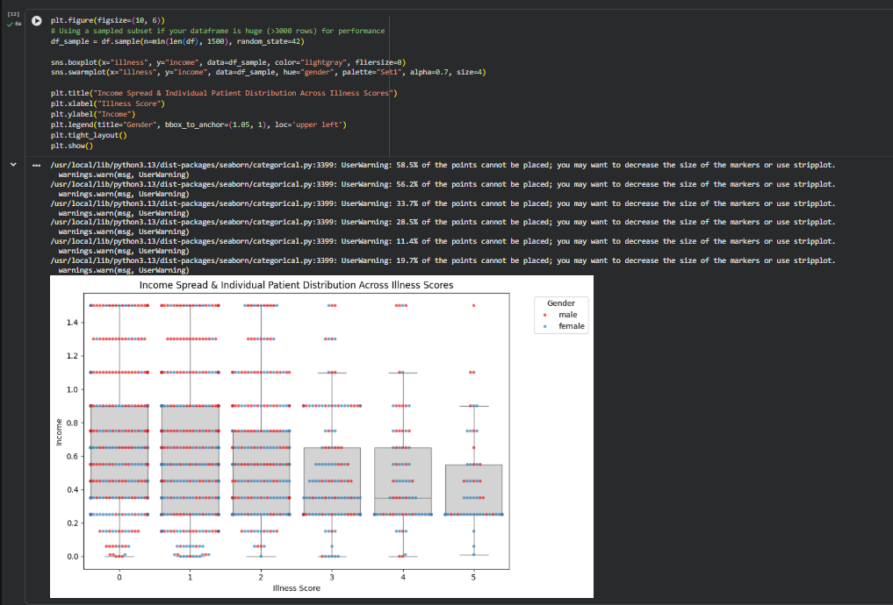
RESULTS: BOX PLOT GRAPH
Here is a summary description of the box plot graphs displayed in the analysis results:
Income Distribution by Private Health Insurance Status (Left Plot): A box plot comparing the income levels of patients grouped by whether they hold private health insurance (yes vs. no), highlighting differences in median income and spread between the two groups.
Income Spread & Individual Patient Distribution Across Illness Scores (Right Plot): A combined box and strip plot displaying the spread of patient incomes across different illness scores, further categorized by gender.
https://github.com/pragyasrivastavaaa/TIRTC-PROJECT-VOIS-INTERNSHIP-Healthcare-Analytics-for-Doctor-Visits.git

Slide 12
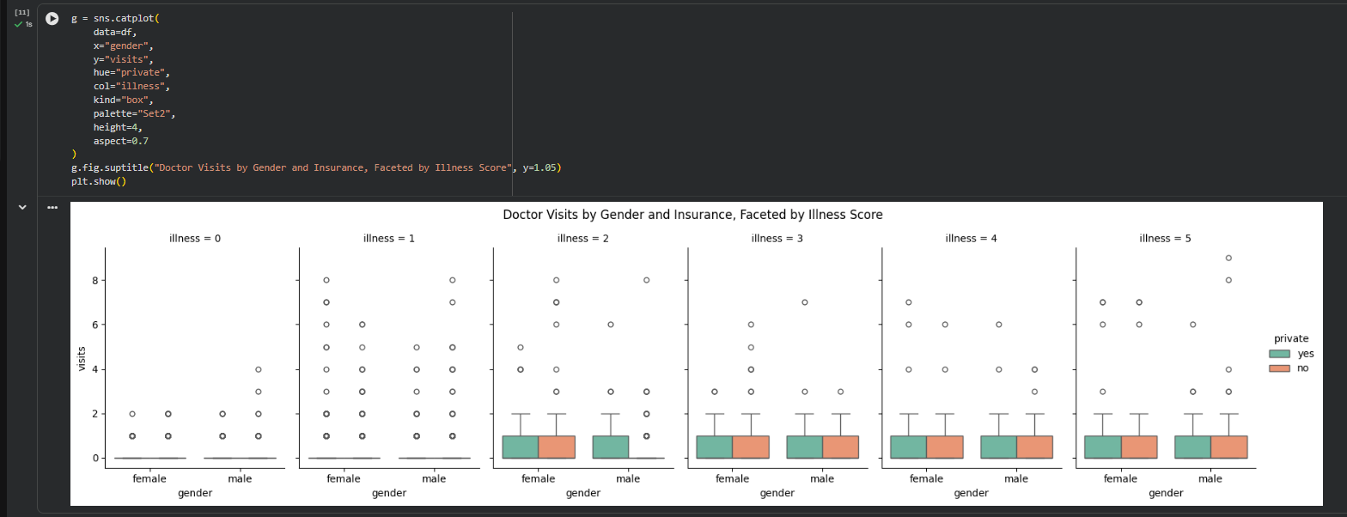
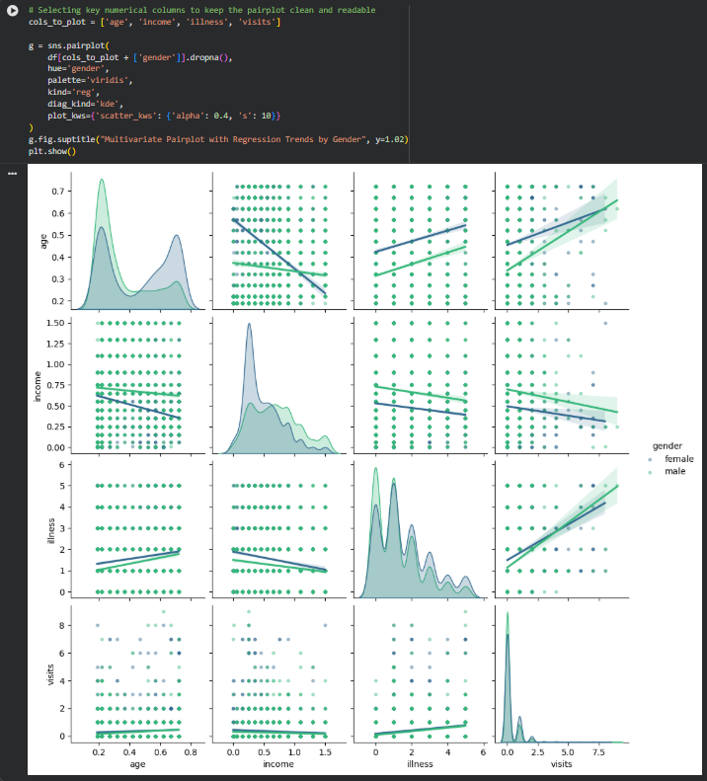
RESULTS: CAT PLOT AND PAIR PLOT GRAPHS
Here is a summary description of the cat plot and pair plot graphs displayed in the analysis results:
Doctor Visits by Gender and Insurance, Faceted by Illness Score (Left Plot): A categorical plot (catplot) displaying box plots and data distributions of doctor visits by gender and private insurance status, broken down (faceted) across different illness score levels from $0$ to $5$.
Multivariate Pairplot with Regression Trends by Gender (Right Plot): A pair plot matrix illustrating pairwise relationships, KDE distributions, and regression trends among key numerical features (such as age, income, illness, and visits), categorized by gender.
https://github.com/pragyasrivastavaaa/TIRTC-PROJECT-VOIS-INTERNSHIP-Healthcare-Analytics-for-Doctor-Visits.git

Slide 13
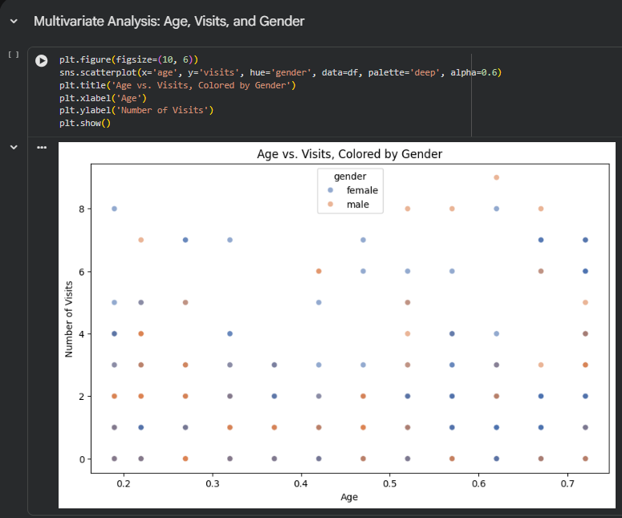
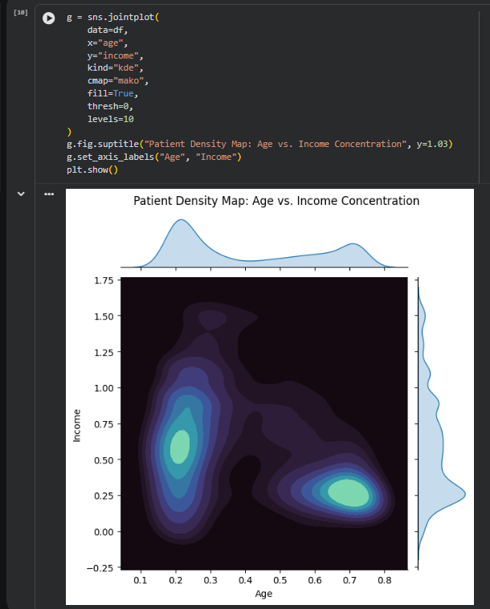
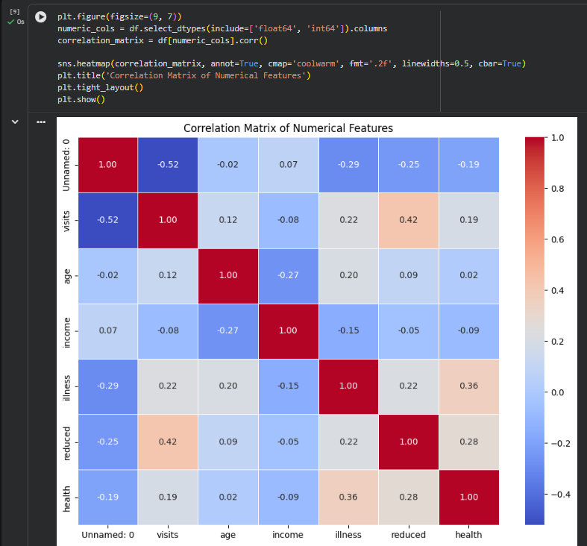
RESULTS: SCATTER PLOT,JOINT PLOT & HEATMAP
Here is a summary description of the plots displayed in the analysis results:
Age vs. Visits, Colored by Gender (Left Plot): A scatter plot displaying the relationship between patient age and the number of doctor visits, with data points differentiated by gender.
Patient Density Map: Age vs. Income Concentration (Middle Plot): A joint density plot illustrating the concentration and distribution of patients across age and income levels, accompanied by marginal distributions.
Correlation Matrix of Numerical Features (Right Plot): A heatmap showing the correlation coefficients among various numerical features in the dataset, such as visits, age, income, and illness
https://github.com/pragyasrivastavaaa/TIRTC-PROJECT-VOIS-INTERNSHIP-Healthcare-Analytics-for-Doctor-Visits.git

Slide 14
GitHub Link
https://github.com/pragyasrivastavaaa/TIRTC-PROJECT-VOIS-INTERNSHIP-Healthcare-Analytics-for-Doctor-Visits.git

Slide 15

VOIS Course completion certificate -
Course name- Data Visualization

Slide 16
THANK YOU
.
.

